Slide 1
Hello and Welcome!
Introduction
Syllabus
MyStatLab demo
Excel data analysis toolpak installation demo
Motivation and examples
This week:
Population and sample
Graphical statistics
Descriptive statistics

Slide 2
Population and Sample (1.3)
POPULATION A population consists of all the items or individuals about which you want to draw a conclusion. The population is the “large group” SAMPLE A sample is the portion of a population selected for analysis. The sample is the “small group”
Chap 1-<number>
Notes:
Prior to this: introduction, syllabus, MyStatLab demo, Excel data analysis toolpak demo.

Slide 3
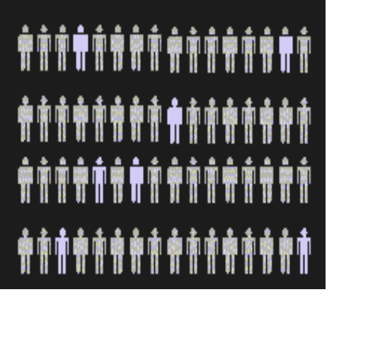
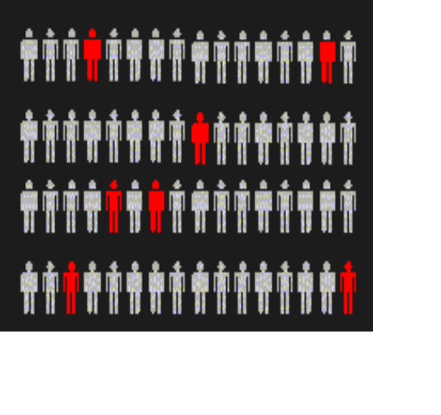
Population vs. Sample
Population
Sample
All the items or individuals about which you want to draw conclusion(s)
A portion of the population of items or individuals
Chap 1-<number>

Slide 4
Probability Sample:
Simple Random Sample
Every individual or item from the frame has an equal chance of being selected
Samples obtained from table of random numbers or computer random number generators.
Chap 1-<number>

Slide 5
Examples
Wrong sampling practice. 1936 US Presidential Elections. Literary Digest collected a sample of size n=10,000,000 which was heavily biased. Got a wrong prediction.
Good sampling practice. 1980 trial of Chrysler Corporation vs. United States Environmental Protection Agency. A very clean sample of n=10 cars provided a bulletproof evidence.
Chap 1-<number>

Slide 6
Graphical Statistics (2.3-2.5)
Before you do anything with your data,
look at it
  In Excel: INSERT → CHARTS
  Data Analysis Toolpak → Histogram

Slide 7
Types of Variables
Categorical (qualitative) variables have values that can only be placed into categories, such as “yes” and “no”; major; architectural style; etc.
Numerical (quantitative) variables have values that represent quantities.
  Discrete variables arise from a counting process
  Continuous variables arise from a measuring process
.
Chap 1-<number>

Slide 8
Types of Variables
Variables
Categorical
Numerical
Examples:
Marital Status
Political Party
Eye Color
(Defined categories)
Discrete
Continuous
Examples:
Number of Children
Defects per hour
(Counted items)
Examples:
Weight
Voltage
(Measured characteristics)
.
Chap 1-<number>

Slide 9
Levels of Measurement
A nominal scale classifies data into distinct categories in which no ranking is implied.
Categorical Variables Categories
Personal Computer Ownership
Type of Stocks Owned
Internet Provider
Yes / No
Growth / Value / Other
AT&T, Verizon, Time Warner Cable
.
Chap 1-<number>

Slide 10

Levels of Measurement (con’t.)
An ordinal scale classifies data into distinct categories in which ranking is implied
Categorical Variable Ordered Categories
Student class designation | Freshman, Sophomore, Junior, Senior
Product satisfaction | Satisfied, Neutral, Unsatisfied
Faculty rank | Professor, Associate Professor, Assistant Professor, Instructor
Standard & Poor’s bond ratings | AAA, AA, A, BBB, BB, B, CCC, CC, C, DDD, DD, D
Student Grades | A, B, C, D, F
.
Chap 1-<number>

Slide 11
Levels of Measurement (con’t.)
An interval scale is an ordered scale in which the difference between measurements is a meaningful quantity but the measurements do not have a true zero point.
A ratio scale is an ordered scale in which the difference between the measurements is a meaningful quantity and the measurements have a true zero point.
.
Chap 1-<number>

Slide 12
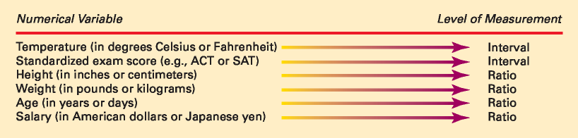
Interval and Ratio Scales
.
Chap 1-<number>

Slide 13
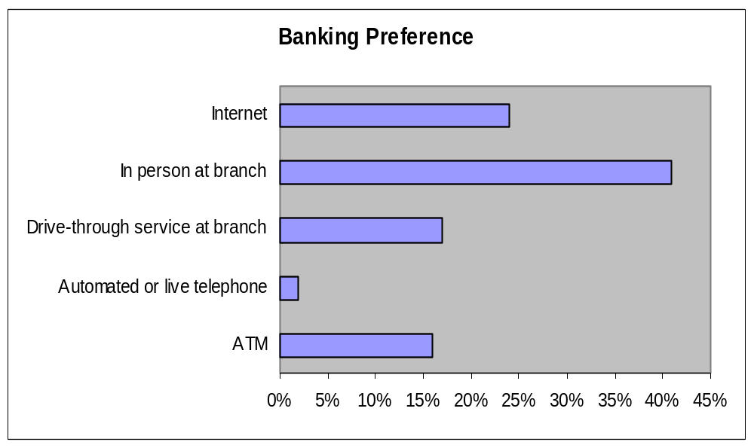
Visualizing Categorical Data:
The Bar Chart
In a bar chart, a bar shows each category, the length of which represents the amount, frequency or percentage of values falling into a category which come from the summary table of the variable.
Banking Preference? | %
ATM | 16%
Automated or live telephone | 2%
Drive-through service at branch | 17%
In person at branch | 41%
Internet | 24%
Chap 2-<number>

Slide 14
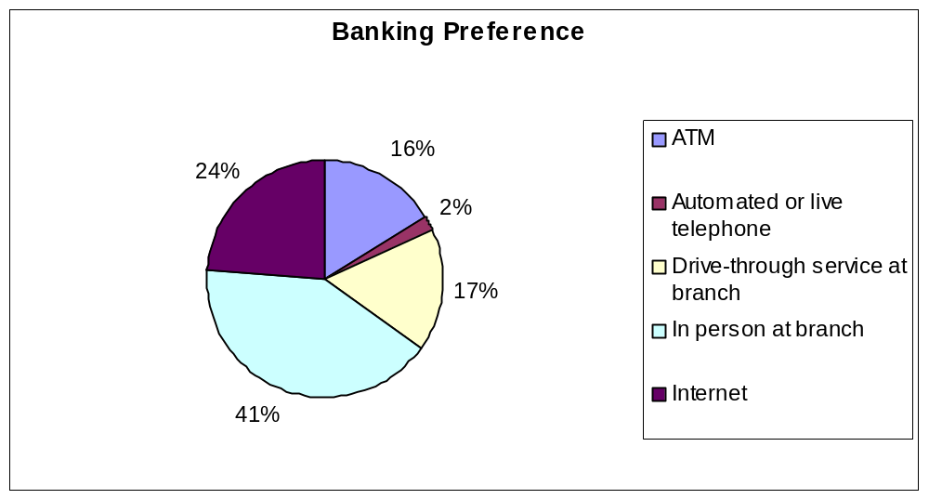
Visualizing Categorical Data:
The Pie Chart
The pie chart is a circle broken up into slices that represent categories. The size of each slice of the pie varies according to the percentage in each category.
Banking Preference? | %
ATM | 16%
Automated or live telephone | 2%
Drive-through service at branch | 17%
In person at branch | 41%
Internet | 24%
Chap 2-<number>

Slide 15
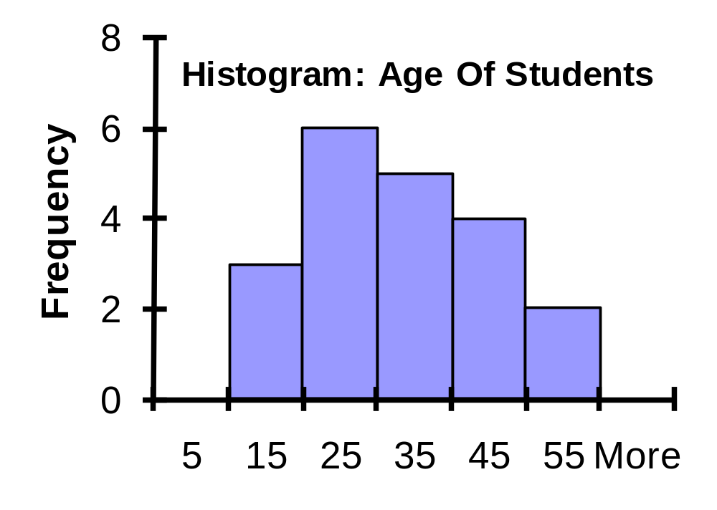
Visualizing Numerical Data:
The Histogram
Relative
Frequency
Percentage
Class Frequency
10 but less than 20 3 .15 15
20 but less than 30 6 .30 30
30 but less than 40 5 .25 25
40 but less than 50 4 .20 20
50 but less than 60 2 .10 10
Total 20 1.00 100
(In a percentage histogram the vertical axis would be defined to show the percentage of observations per class)
Chap 2-<number>

Slide 16
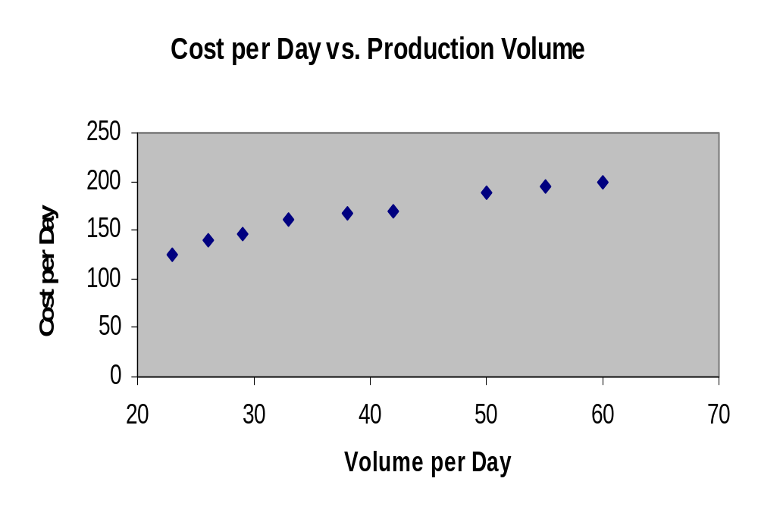
Visualizing Two Numerical Variables: Scatter Plot
Volume per day | Cost per day
23 | 125
26 | 140
29 | 146
33 | 160
38 | 167
42 | 170
50 | 188
55 | 195
60 | 200
Chap 2-<number>

Slide 17
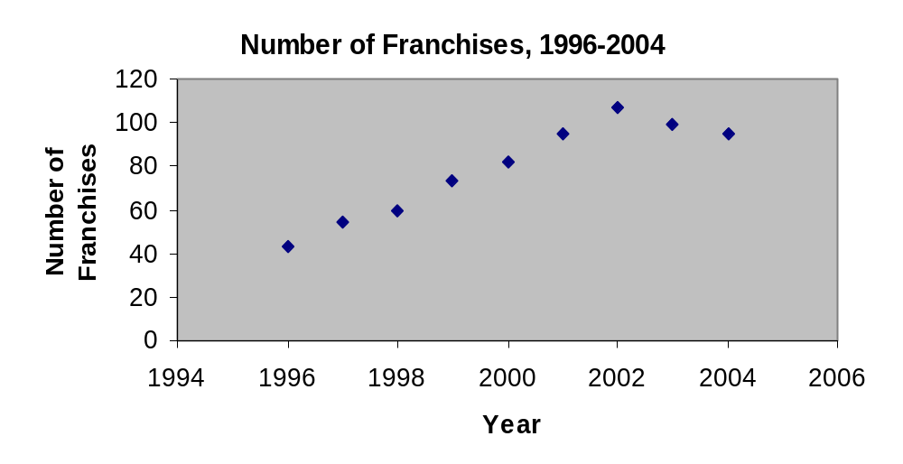
Visualizing Two Numerical Variables: Time Series Plot
Year | Number of Franchises
1996 | 43
1997 | 54
1998 | 60
1999 | 73
2000 | 82
2001 | 95
2002 | 107
2003 | 99
2004 | 95
Chap 2-<number>

Slide 18
Examples
Appliances | % of electricity consumption
AC | 18
Dryers | 5
Washers | 24
Computers | 1
Cooking | 2
Dishes | 2
Freezers | 2
Lighting | 16
Friges | 9
Heating | 7
Water heating | 8
TV etc | 6
Construct a bar chart and a pie chart.
Make conclusions.
Chap 1-<number>

Slide 19
Examples
#2.39, p.58 “Cost of baseball games”.
Dataset BBcost2011 (BBcost2015).
Construct a histogram.
#2.54, p.62 “Stock performance”.
Construct a time series plot. Is there a pattern?
Chap 1-<number>

